Slide 1
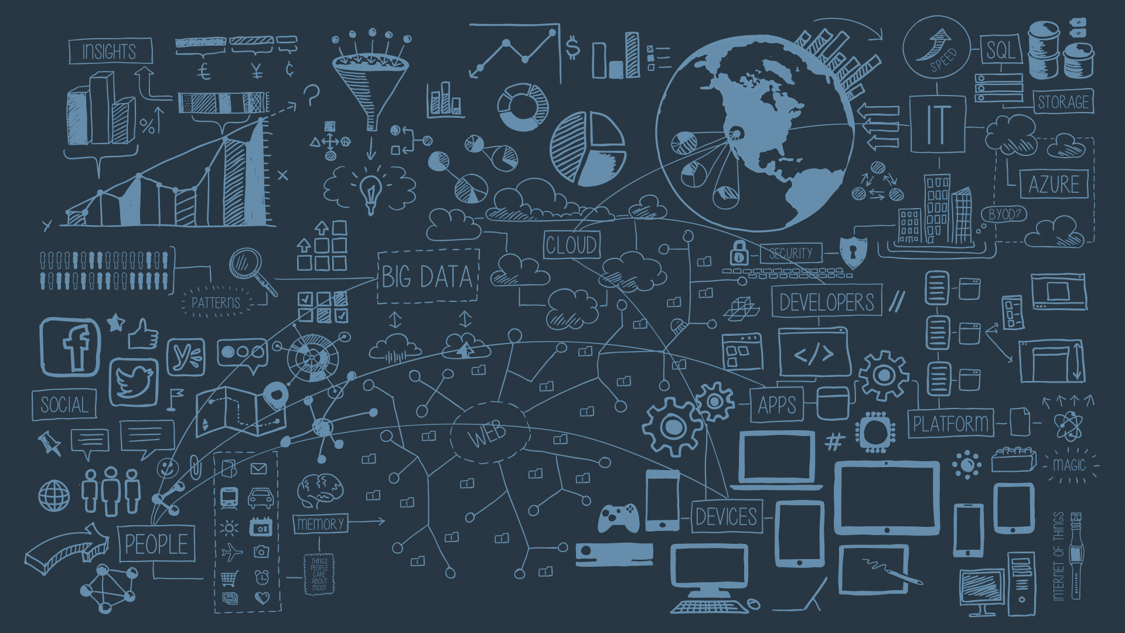
Magic Eyewear
Try Glasses on Virtually
Team Members
Farida Hesham
Ragaa Moustafa
Samiha Hussien
Yara Amr

Slide 2
Agenda
What is Magic Eyewear
Face Detection
vs
Face Recognition
Applying Glasses on Face
Demo

Slide 3
What is Magic Eyewear

Slide 4
What is Magic Eyewear?
Magic Eyewear is a software that lets users try on glasses virtually.
Currently a prototype.
Tools used:
Python
OpenCV
Dlib
Future plans:
More advanced development
Integrating it with website created for EyeCare Optics

Slide 5
Face Detection vs Face Recognition

Slide 6
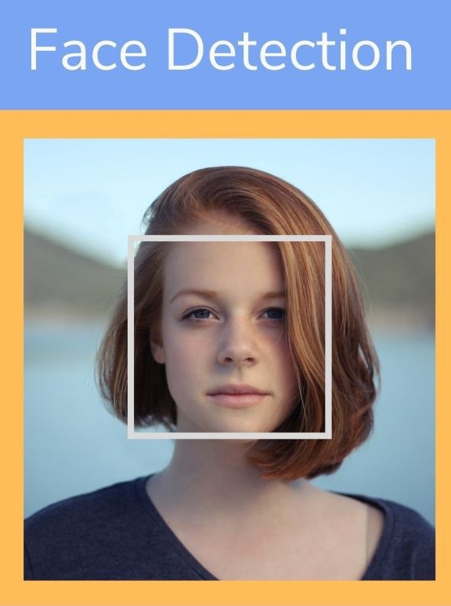

Face Detection vs Face Recognition
Face Detection
Ability to recognize the presence of people’s faces.
Face Recognition
Ability to not only detect a person’s face but also recognize their identity.
Magic Eyewear only uses face detection.

Slide 7
Applying Glasses
on Face

Slide 8
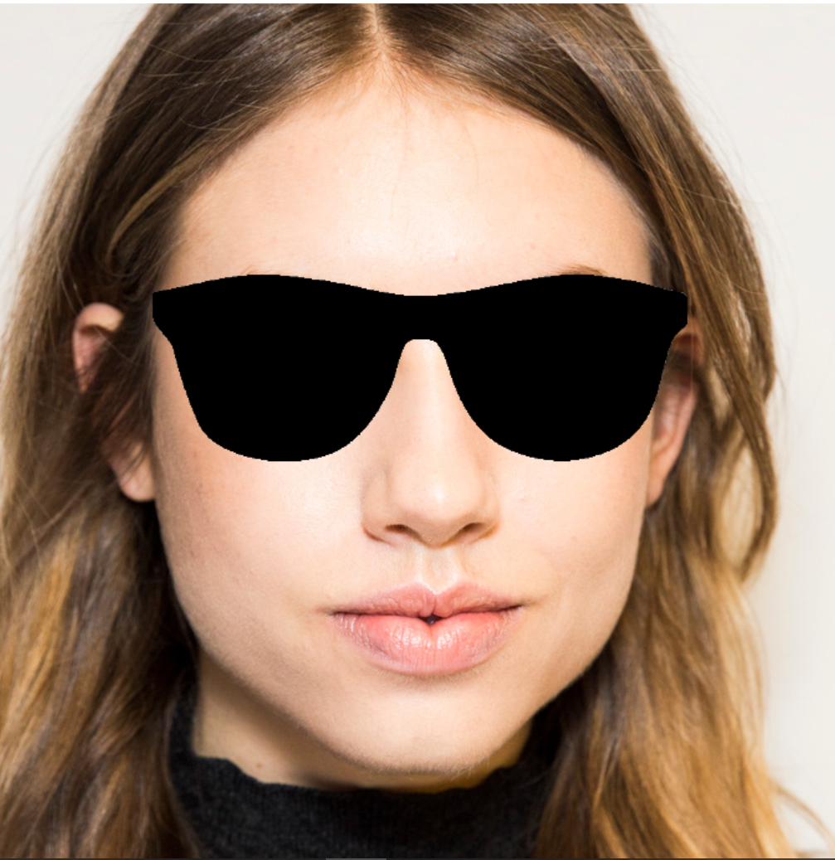
1) Glasses On A Picture
Based on OpenCV’s haarcascades.
Applies a frame on a still picture.

Slide 9
2) Glasses On A Pre-Recorded Video
Based on landmarks.
Uses imutils and argparse libraries to speed up the frames per second (FPS).

Slide 10
3) Glasses On A Live Video
Based on landmarks.
Processes a person’s face, applies landmark points on the eyes area, then puts the frame on their face.

Slide 11
Demo

